Slide 1
Project Name
Develpoers Biodata Application

Slide 2
Team Details
TEAM NAME | Rising Developpers
TEAM EMAIL | risingdeveloppers@gmail.com
TEAM GITHUB | RisingDeveloppers
Rising Developpers | NAME | QUALIFICATION | EMAIL | PHONE NO | PLACE
LEADER | D.S.SUJITH | B.E | dassujith1@gmail.com | 98942141681 | KULAPPURAM
MEMBER | SHARMI | B.Ed | sharmisekhar1998@gmail.com | 8903596113 | COLACHEL
MEMBER | SHAJINI | DCA COMPUTER | shajinishajini985@gmail.com | 8606886894 | MARTHANDAM
MEMBER | BANU | M.Com | banuchenthil70@gmail.com | 7339453678 | KOTTAR
MEMBER | BANUPRIYA | B.Ed | banupriya021991@gmail.com | 9047467287 | KOTTAR
Notes:
-Add team details with name and qualification,e-mail,phone no and place

Slide 3
Database Design
id
user_code
coursename
university
college
passyear
percentage
id
user_code
name
address
email
mobile
profile
objective
declaration
Id
name
username
password
email
mobileno
userdetails
education_details
basic_detail
biodata
experience_details
technology_detail
personal_details
Id
user_code
organization_name
experience
role
id
user_code
experience_type
experience_detail
id
user_code
personal_type
personal_detail
Notes:
Get the database design from the phpmyadmin or from SRS document

Slide 4
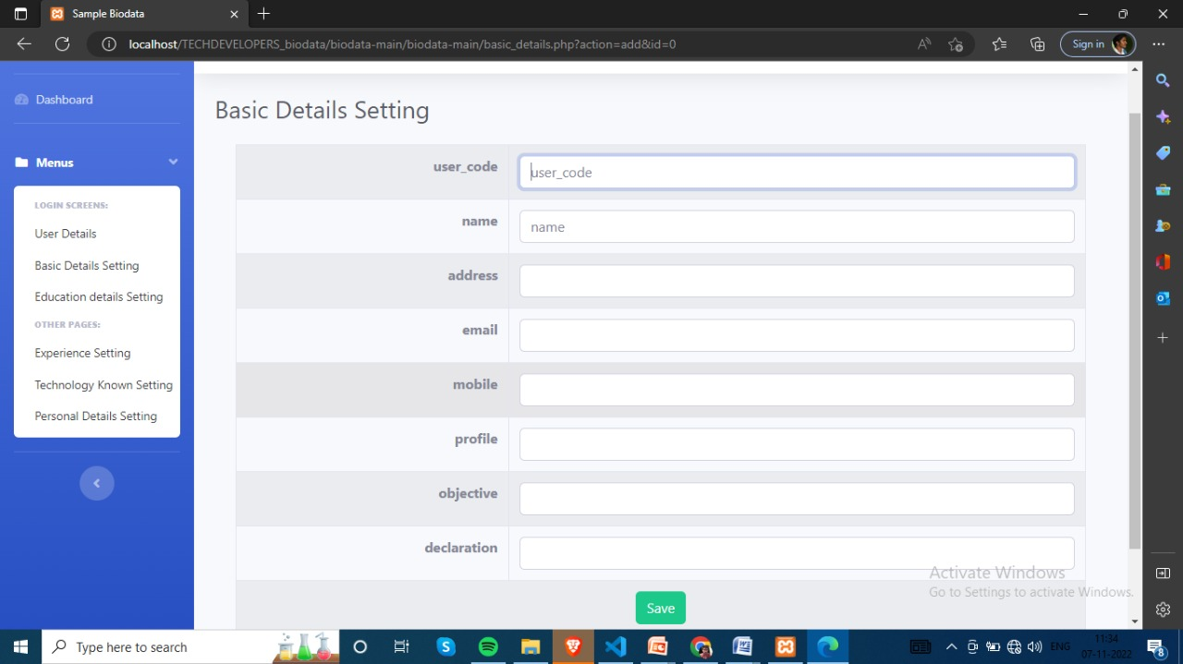
Form Design
user_code
name
address
email
mobile
profile
objective
declaration

Slide 5
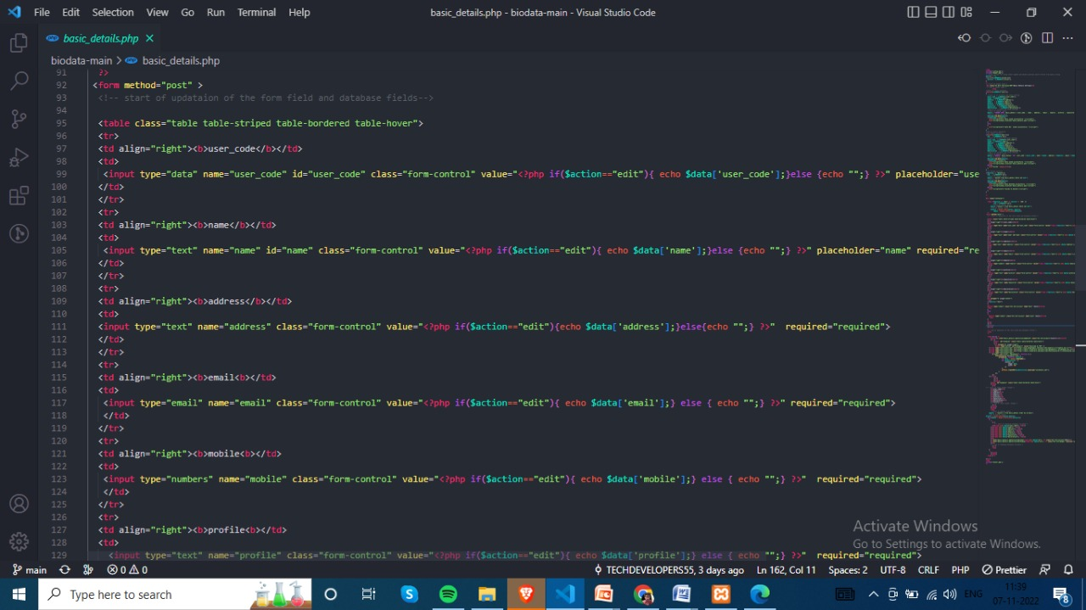
Sample Source code
Inside the form tag <form>
inside a table<table>
Create the input details of basic_details based on the SSR document
In save button to give the correct path to save the values to the database
Give the correct query to all operation (edit,delete) based on the SSR documents corresponding tables.

Slide 6
Problem/difficulty Faced
Uploading the project to the github via tortoise git to remote Repositories an authentication error displayed
Solution
update the correct authentication details (username & pasword) to the coresponding login page

Slide 7
TEAM MEMBER -1

Slide 8
Forms & Database Design
Import the database to the my server which is already created by our team.
Create a education_details menu based on the SSR document.
Input the correct details based on the SSR documents in the sample source code
Also clearly give the correct query which is created based on the corresponding menu.
Notes:
Explain Form and database worked with

Slide 9
Problem/difficulty Faced
Importing the project database to the server
Running the project the database error displayed.
Notes:
Explain problem faced

Slide 10
Solution to the problem
First I import the database name which is not match to the corresponding database name in the SSR document.
Recreate the database which is same name as the SSR document and import the database into it.
Notes:
Explain how attained the solution

Slide 11
Sample Source code
Enter the correct table name and correct values of the table
Give the correct path to the all of the location where the path is needed.
Finally run the application
Entering the values the data saved to the database.
Notes:
Explain how attained the solution

Slide 12
TEAM MEMBER -2

Slide 13
Forms & Database Design
Import the database to the my server which is already created by our team.
Create a experience_details.php menu based on the SSR docucument.
Input the correct details based on the SSR documents in the sample source code
Also clearly give the correct query which is created based on the corresponding menu.

Slide 14
Problem/difficulty Faced
Update the values to the source code without declare a variable
In query section it is not match to the input values
Running the application error displayed.

Slide 15
Solution to the problem
Declare the variables to all the input values
Entering the variables correctly in the corresponding values

Slide 16
Sample Source code
Declare the correct variable to the correct value
Give the correct path to the all of the location where the path is needed.
Finally run the application
Entering the values the data saved to the database.
Notes:
Explain how attained the solution

Slide 17
TEAM MEMBER -3

Slide 18
Forms & Database Design
Import the database to the my server which is already created by our team.
Create a technology_details.php menu based on the SSR docucument.
Input the correct details based on the SSR documents in the sample source code
Also clearly give the correct query which is created based on the corresponding menu.

Slide 19
Problem/difficulty Faced
Running the application an error displayed like ( unclosed “{“ )

Slide 20
Solution to the problem
Missing some closing braces ’}’ in alocation.
Find out and clearit.

Slide 21
Sample Source code
Find the location missing the curly braces and close it.
Add all the details based on the SSR documents
Run the application.
Finally the problem solved data saved successfully.

Slide 22
Thank You

